Slide 1
Image Style Transfer Using Convolutional Neural Networks
박은화

Slide 2
목차
Introduction
Deep image representations
Results
Discussion

Slide 3
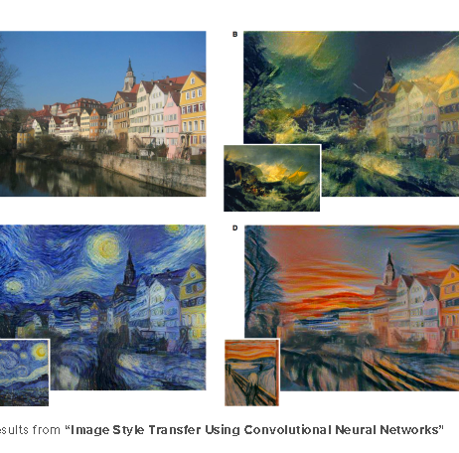
Introduction

Slide 4
Introduction
Transferring the style from one image onto another can be considered a problem of texture transfer.
The goal is to synthesize a texture from a source image while constraining the texture synthesis in order to preserve the semantic content of a target image.
A fundamental prerequisite is to find image representations.
➔ High-performing Convolutional Neural Networks can be used to independently process and manipulate the content and the style of natural images.

Slide 5
Deep Image Representations
VGG network.
Average pooling.
ReLU(Rectified Linear Unit)

Slide 6
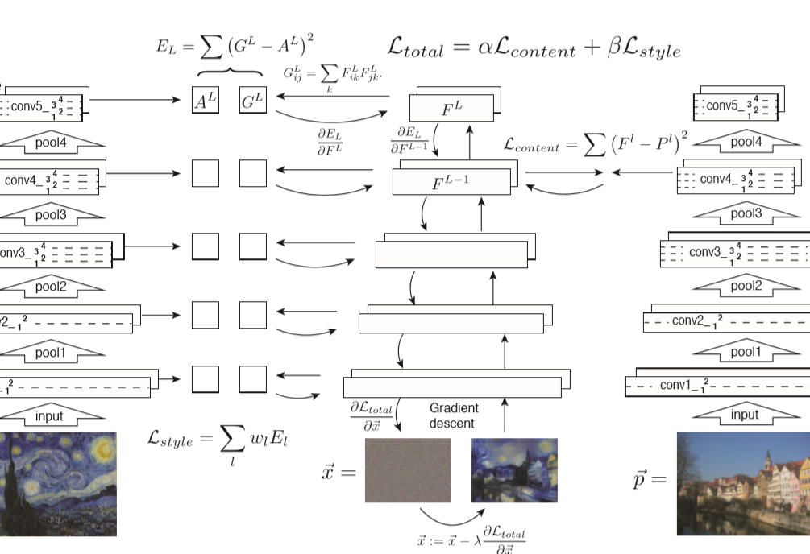
Deep Image Representations

Slide 7


Content representation
Squared-error loss
Derivative of loss
Change the initially random image x until it generates the same response in a certain layer of the CNN as the original image p.

Slide 8
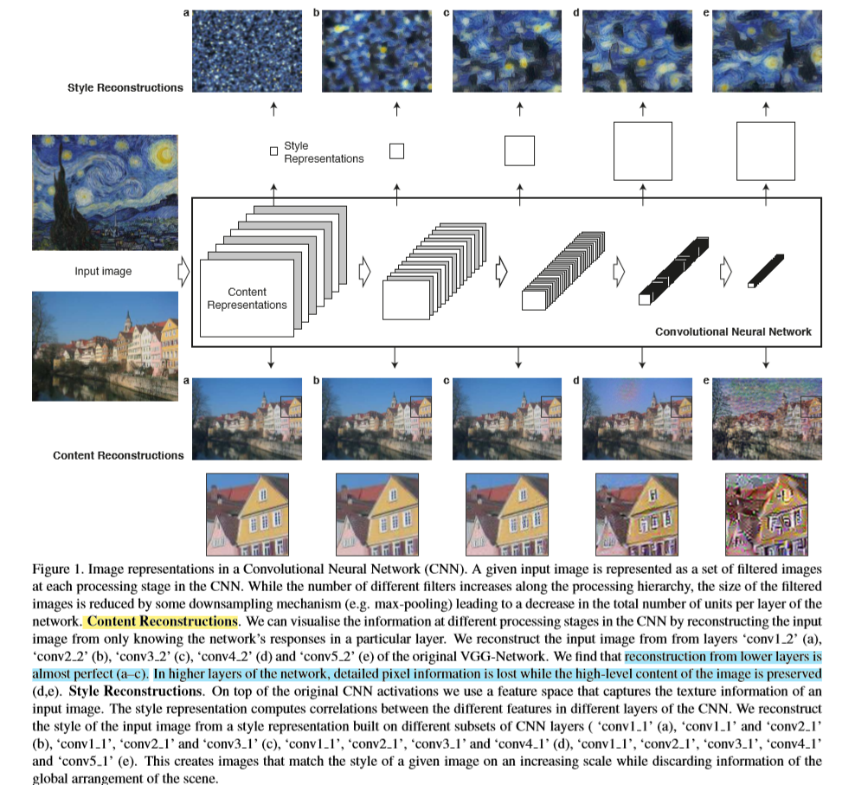
Content representation

Slide 9

Style representation
Use a feature space designed to capture texture information. It consists of the correlations between the different filter responses, where the expectation is taken over the spatial extent of the feature maps. ➔ Gram Matrix
Gram Matrix G:
➔ 한 벡터의 모든 성분 간의 내적 정보가 모두 담겨 있어 백터 내의 상관관계를 구할 때 자주 사용되는 행렬

Slide 10



Style representation
Style loss of layer l
The total style loss
Derivative of E

Slide 11
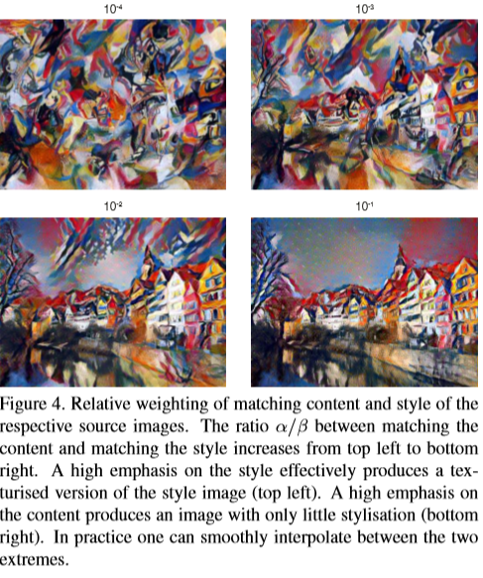

Style transfer
The Loss function we minimize:

Slide 12
Results
The representations of content and style in CNN are well separable.
Manipulate both representations independently to produce new, perceptually meaningful images.
Initialization.

Slide 13
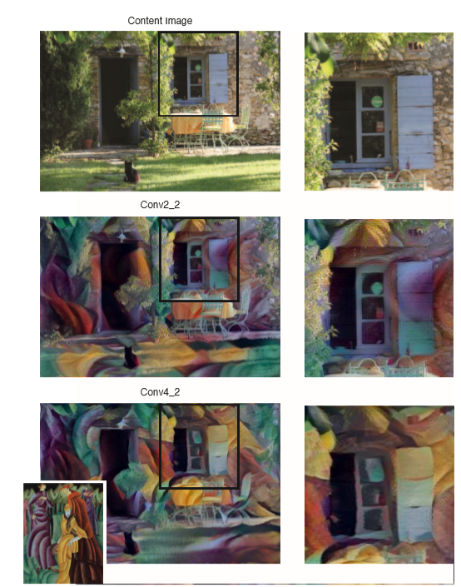
Results
Another important factor in the image synthesis process is the choice of layers to match the content and style representation on.
Higher layer: X detailed pixel, O properly merged.

Slide 14
Discussion
Limitations
Resolution of the synthesized images. Dimensionality of the optimization problem as well as the number of units in the CNN grow linearly with the number of pixels. Therefore the speed of the synthesis procedure depends heavily on image resolution.
Synthesized images are sometimes subject to some low-level noise.

